Slide 1

Inheritance
Week 7

Slide 2
Agenda
Recap of the Last Lecture
Inheritance basics
Using Super
Creating a multilevel hierarchy
Method Overriding
Dynamic Method Dispatching
Using abstract classes
Using final with inheritance
The object class
Recap of the lecture

Slide 3
Inheritance Basics
Inheritance is one main pillars of object-oriented programming.
Using inheritance, we can create general or super class which then can be inherited by other, more specific or child classes or sub classes.
Therefore, a subclass is a specialized version of a superclass. It inherits all the members defined by the superclass and adds its own, unique elements.
Use of extends keyword for inheritance.

Slide 4
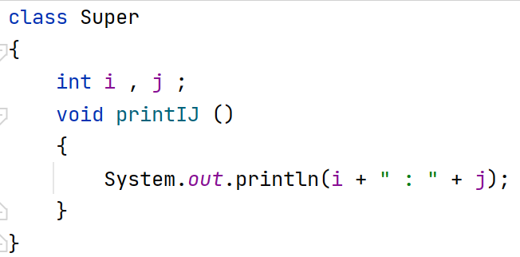
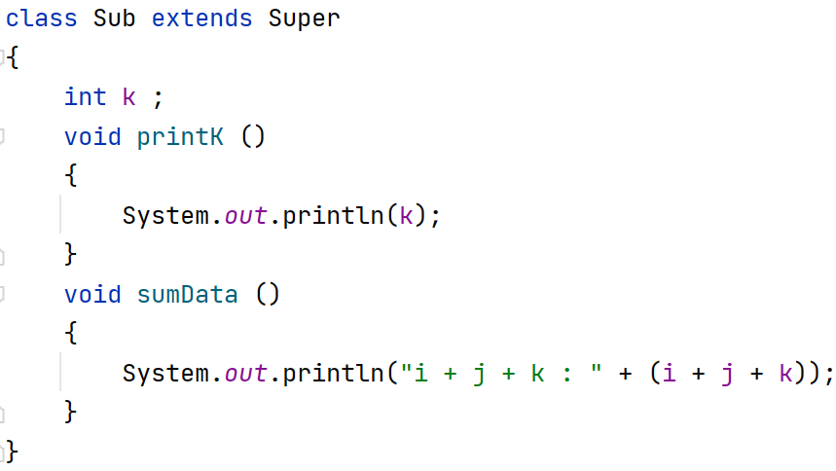

Slide 5
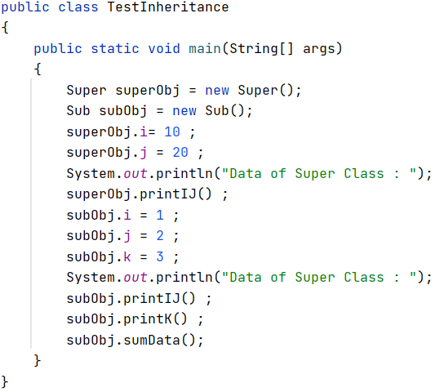
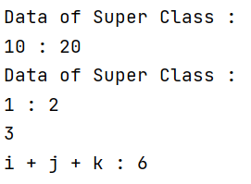

Slide 6
Member Access and Inheritance
Although a subclass includes all the members of its superclass, it cannot access those members of the superclass that have been declared as private.

Slide 7
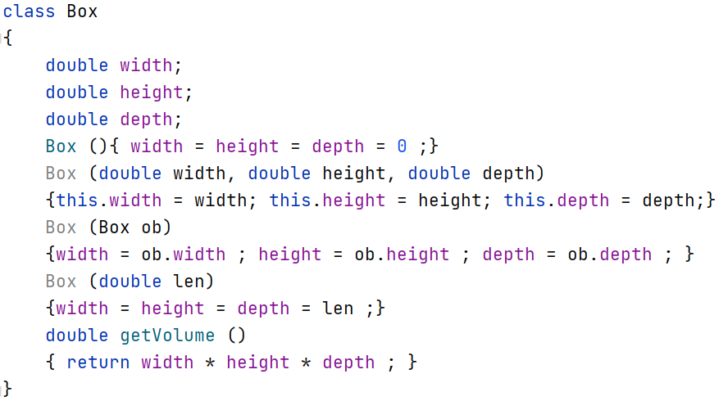

Slide 8
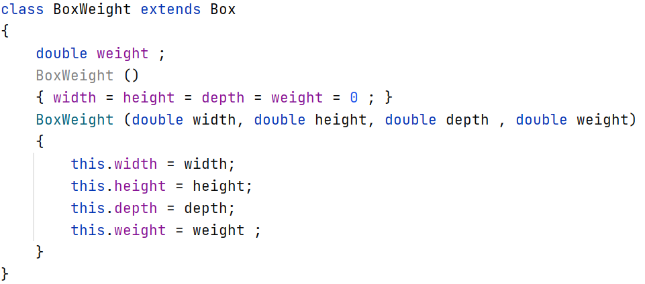

Slide 9
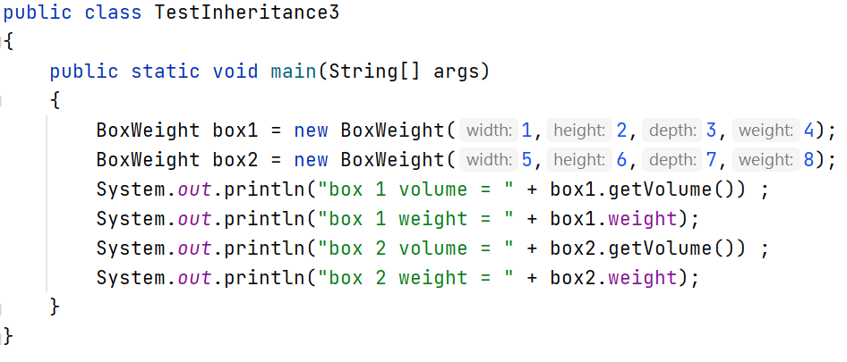
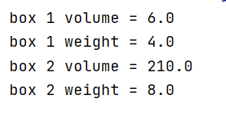

Slide 10
Super Class Variable Can Reference a Sub Class Object
A reference variable of a superclass can be assigned a reference to any subclass
derived from that superclass.

Slide 11
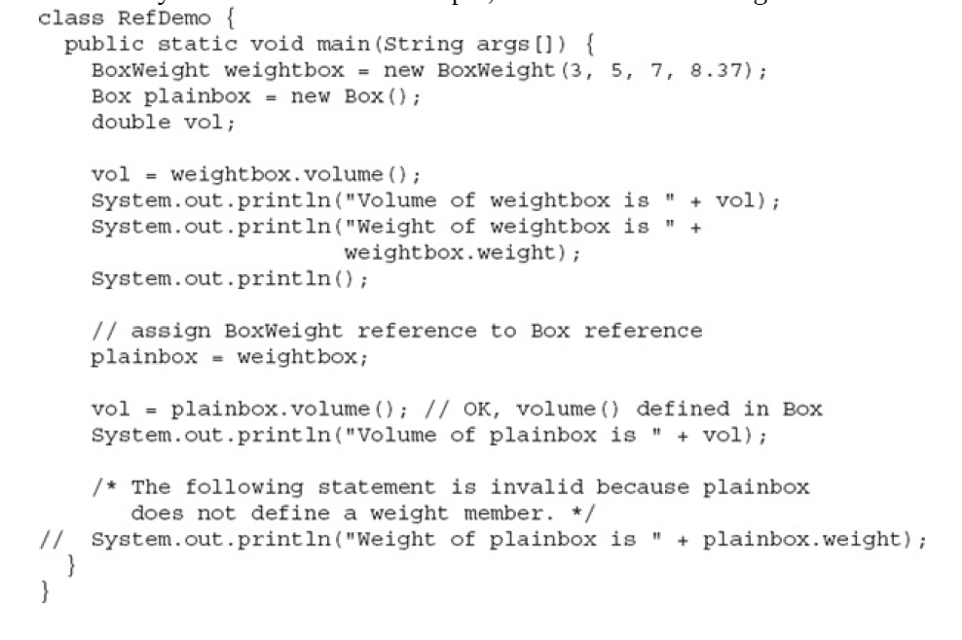

Slide 12
Using Super Keyword
A subclass can call a constructor defined by its superclass by use of the following form of super:
super(arg-list);
Here, arg-list specifies any arguments needed by the constructor in the superclass.
super( ) must always be the first statement executed inside a subclass’ constructor.

Slide 13
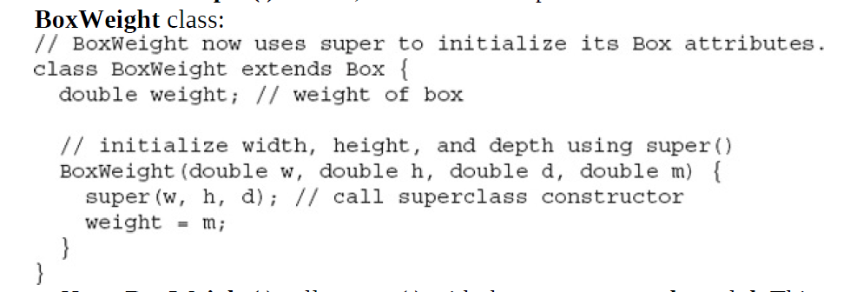

Slide 14
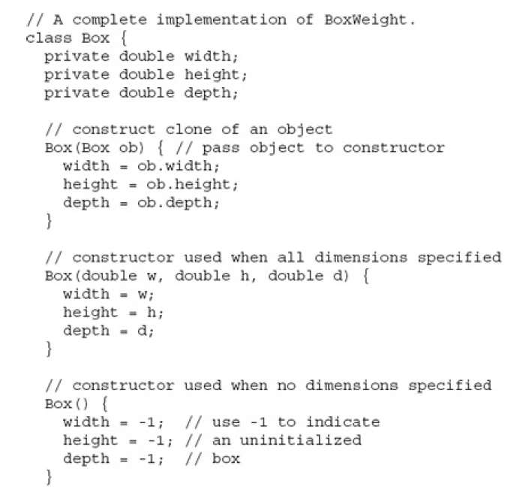

Slide 15
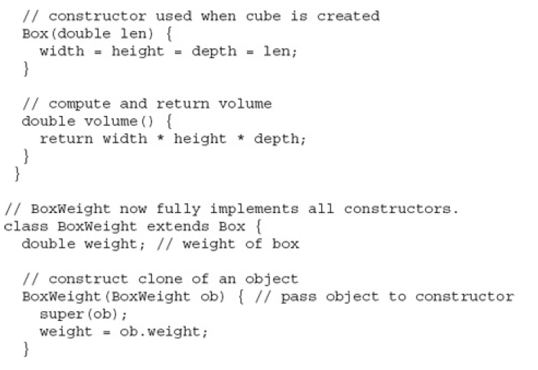

Slide 16
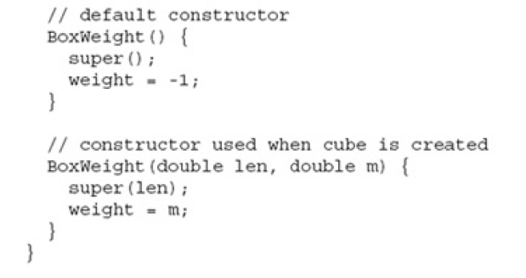

Slide 17
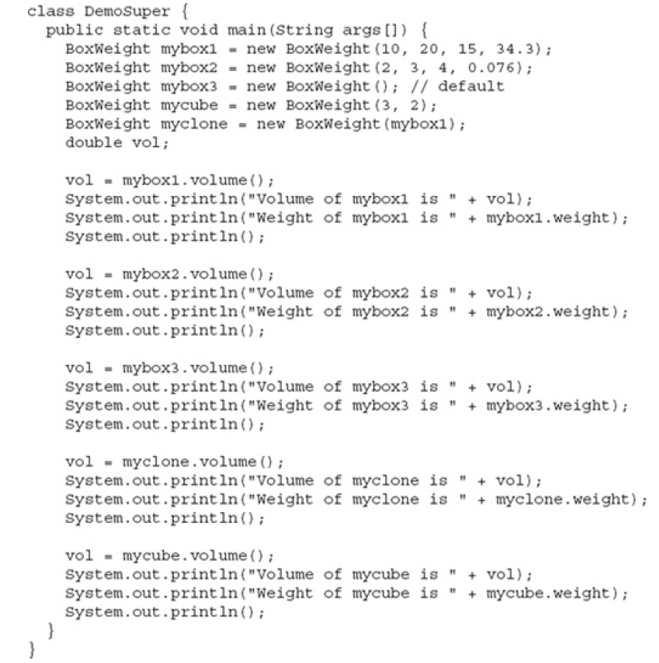

Slide 18
Using Super Keyword
The second form of super acts somewhat like this, except that it always refers to
the superclass of the subclass in which it is used.
This usage has the following general form: super.member
Here, member can be either a method or an instance variable.
This second form of super is most applicable to situations in which member names of a subclass hide members by the same name in the superclass.

Slide 19
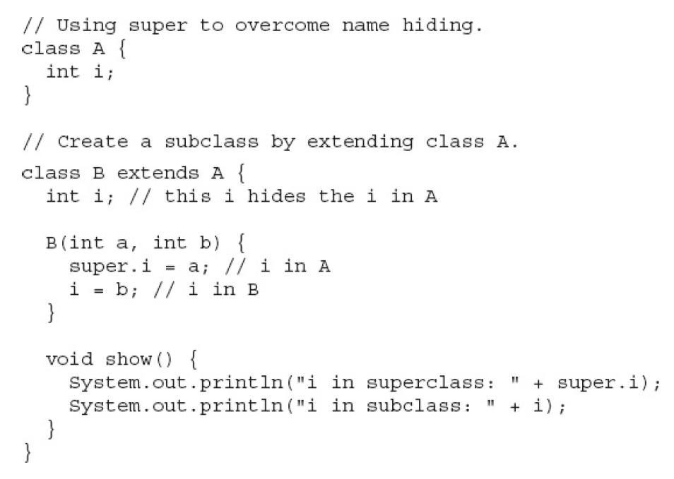

Slide 20
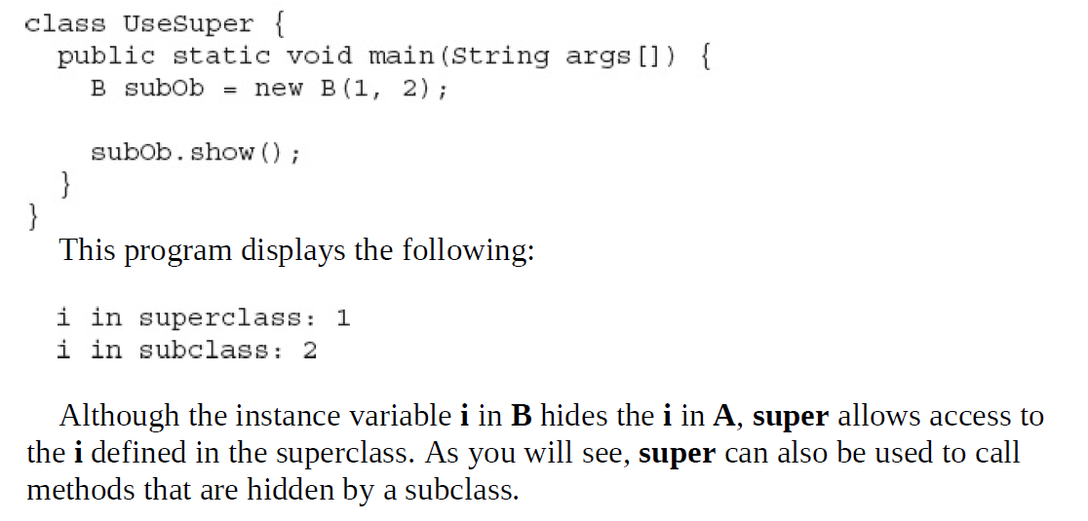

Slide 21
Creating a multi-level heirarchy
The second form of super acts somewhat like this, except that it always refers to
the superclass of the subclass in which it is used.
This usage has the following general form: super.member
Here, member can be either a method or an instance variable.
This second form of super is most applicable to situations in which member names of a subclass hide members by the same name in the superclass.

Slide 22
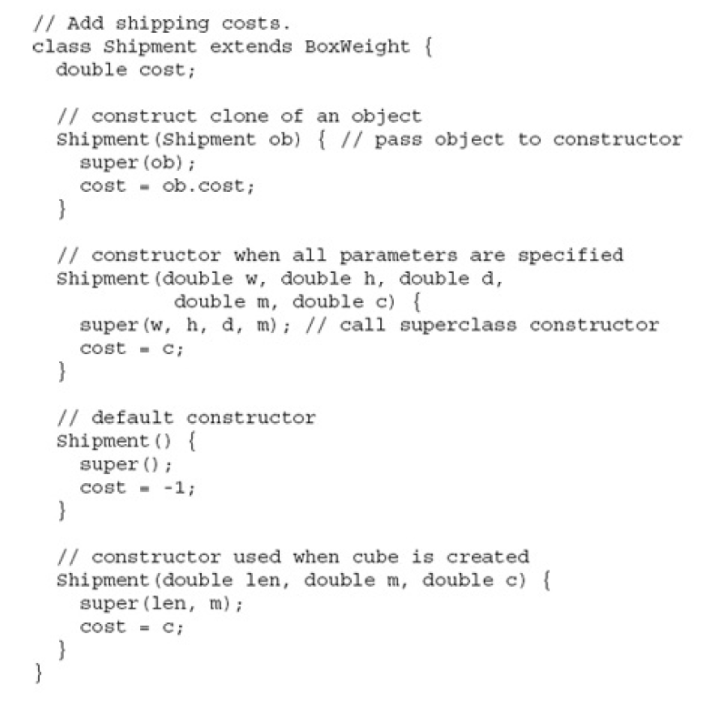

Slide 23
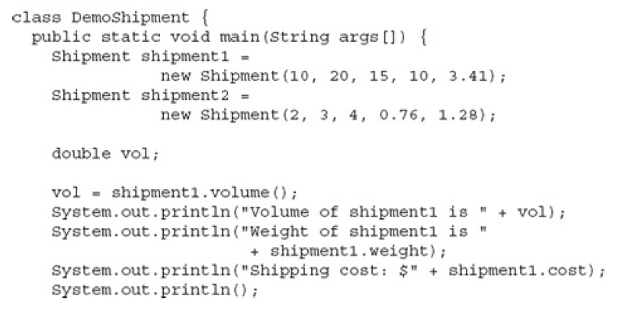
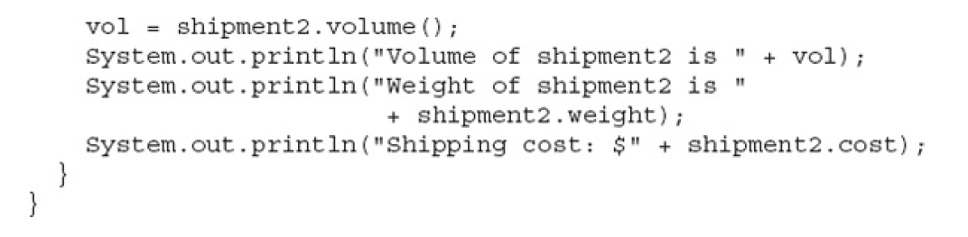

Slide 24
When Constructors are Executed?
In a class hierarchy, constructors complete their execution in order of derivation, from superclass to subclass.

Slide 25
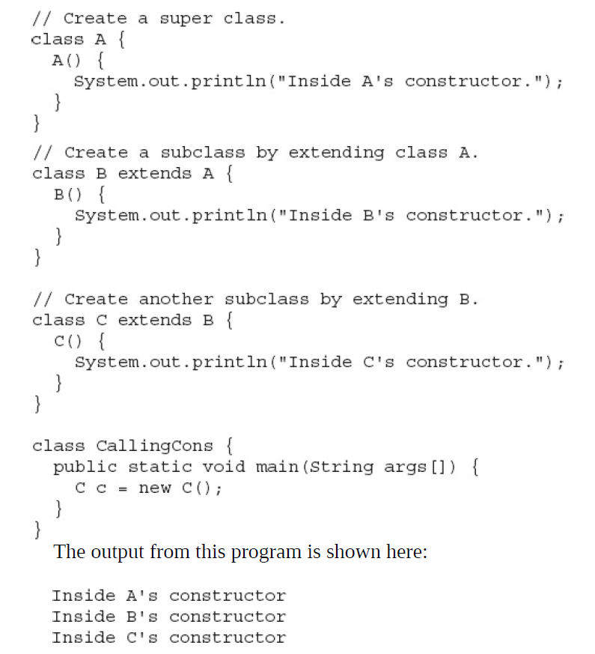

Slide 26
Method Overriding
In a class hierarchy, when a method in a subclass has the same name and type signature as a method in its superclass, then the method in the subclass is said to override the method in the superclass.

Slide 27
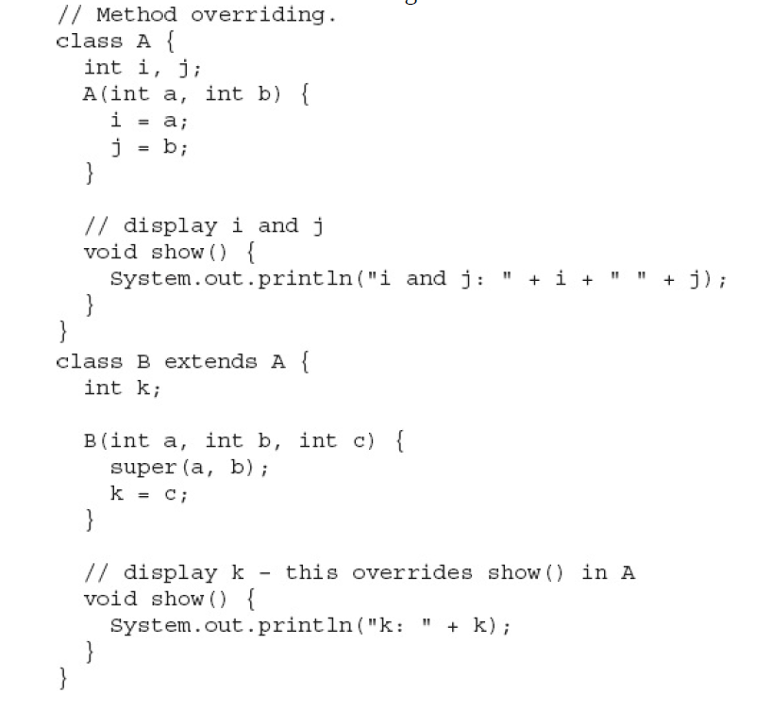

Slide 28
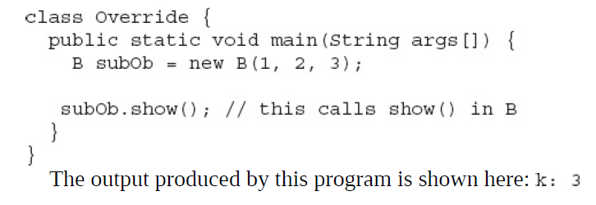

Slide 29
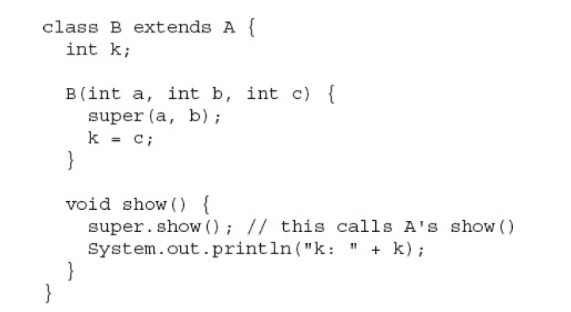

Slide 30
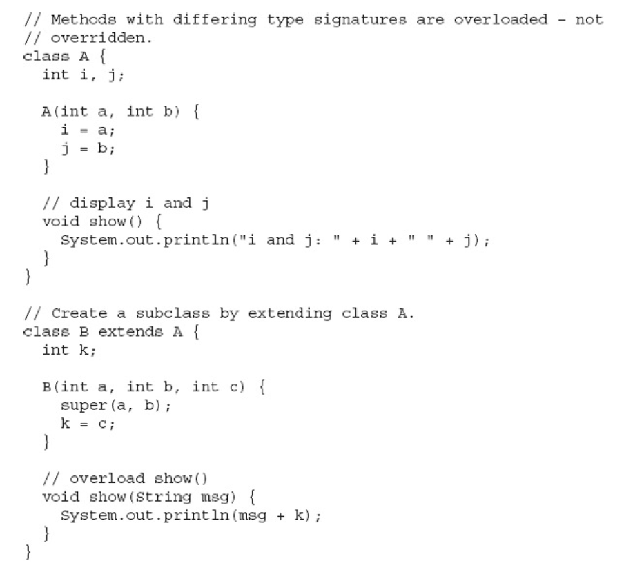

Slide 31
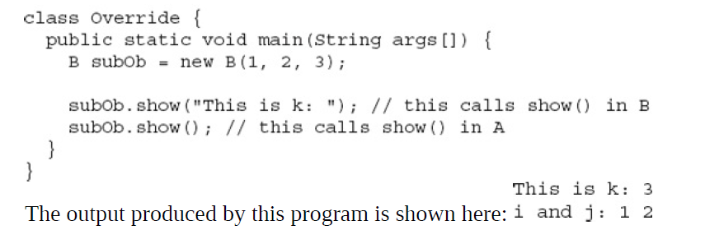

Slide 32
Dynamic Method Dispatching
Dynamic method dispatch is the mechanism by which a call to an overridden method is resolved at run time, rather than compile time.
Dynamic method dispatch is important because this is how Java implements run-time polymorphism.

Slide 33
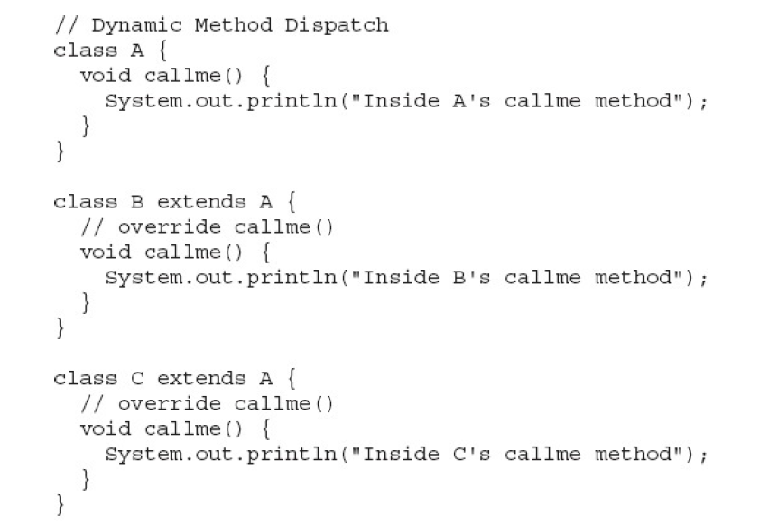

Slide 34
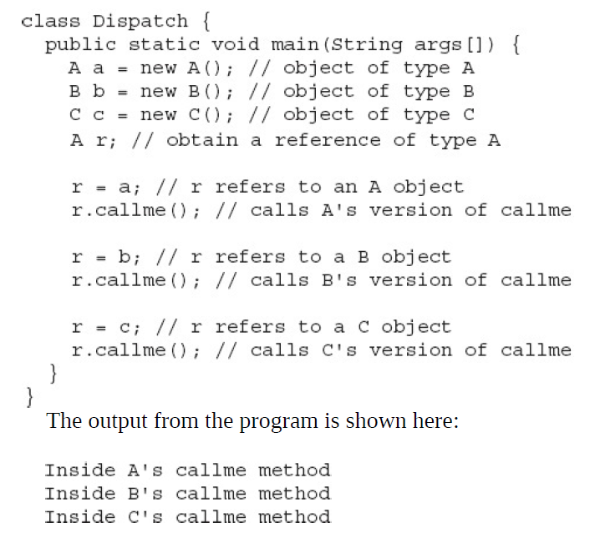

Slide 35
Using final keyword
Three uses
Creating constant variable
Used to prevent method overriding
Used to prevent inheritance

Slide 36
Abstract Classes
Method without definition are declared as abstract.
The class which contains the abstract metho should be declared as abstract

Slide 37
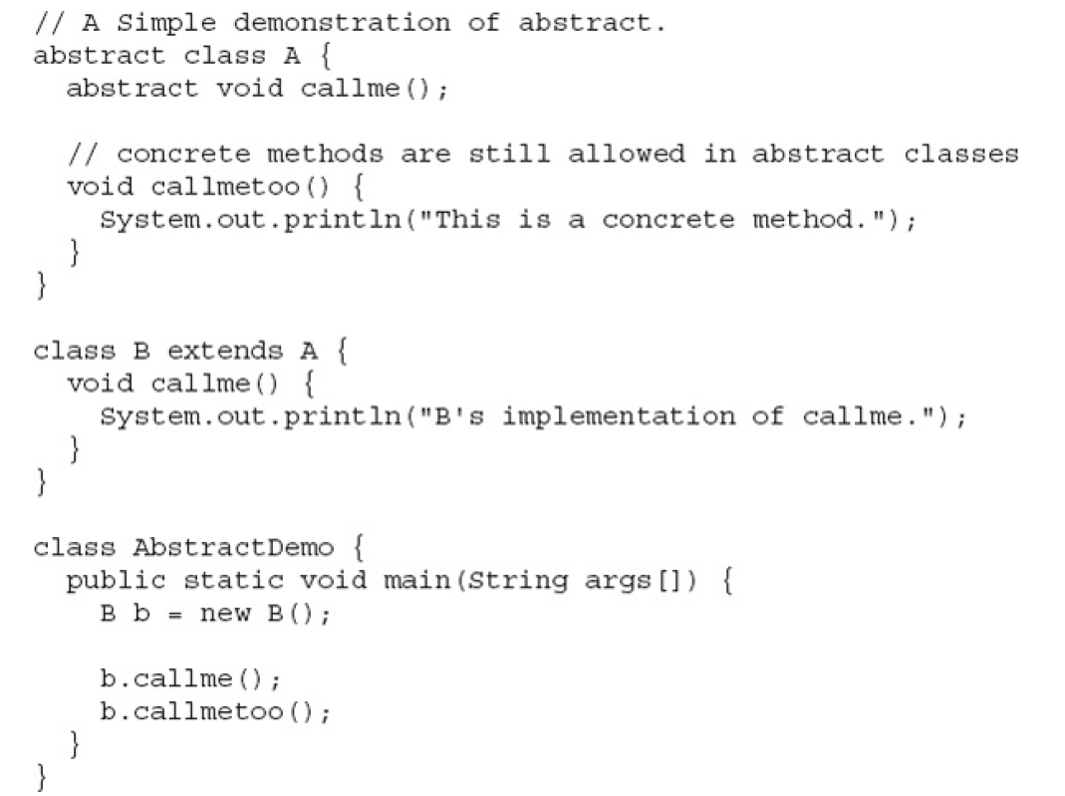

Slide 38
Recap
Inheritance basics
Using Super
Creating a multilevel hierarchy
Method Overriding
Dynamic Method Dispatching
Using abstract classes
Using final with inheritance
The object class

